Slide 1

Breadboarding Circuits for OpenPLC
Dr. David J. Coe
Electrical and Computer Engineering Department
University of Alabama in Huntsville
coed@uah.edu

Slide 2
Outline
Introduction to Arduino
Arduino-OpenPLC Setup
Breadboarding of Circuits
References

Slide 3
Introduction to Arduino

Slide 4
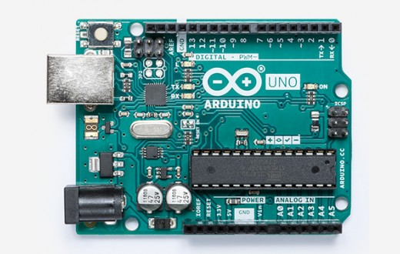
What is an Arduino?
An open source electronics platform for building cyber-physical systems
Cyber-physical systems sense and interact with their surroundings
Arduino Uno
~$22
https://store.arduino.cc/usa/arduino-uno-rev3

Slide 5
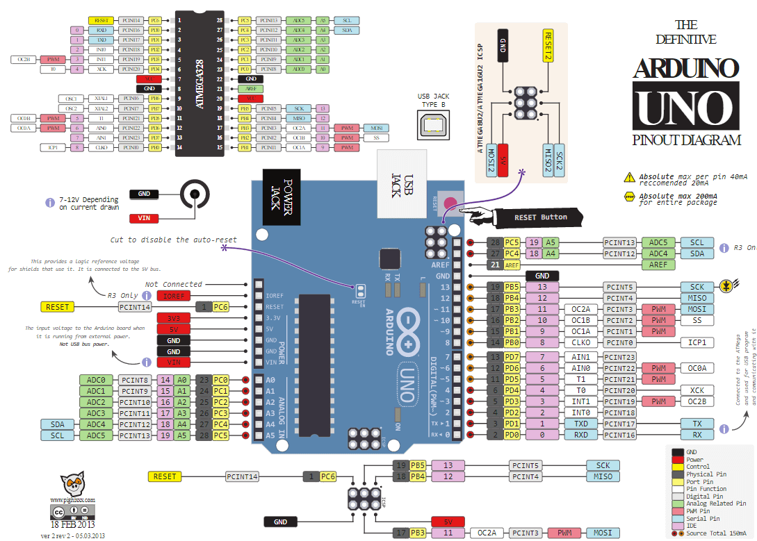
Arduino Uno R3 Pinout
https://www.circuito.io/blog/arduino-uno-pinout/

Slide 6
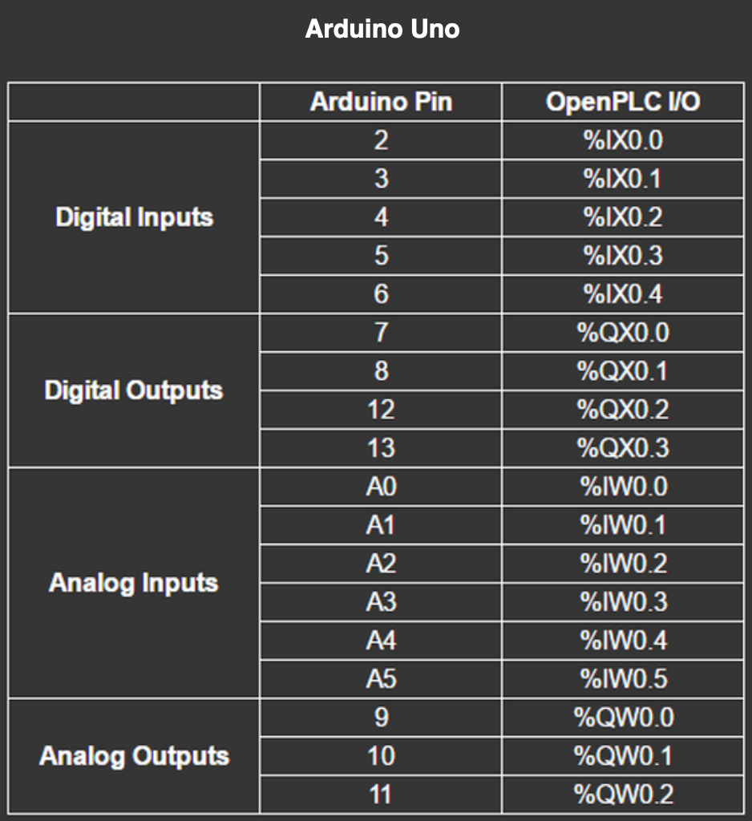
Arduino Uno R3 – OpenPLC Pinout
Slave devices start at 100 so add 100
Example: %IX100.0
https://www.openplcproject.com/getting-started-arduino

Slide 7
Arduino-OpenPLC Setup

Slide 8
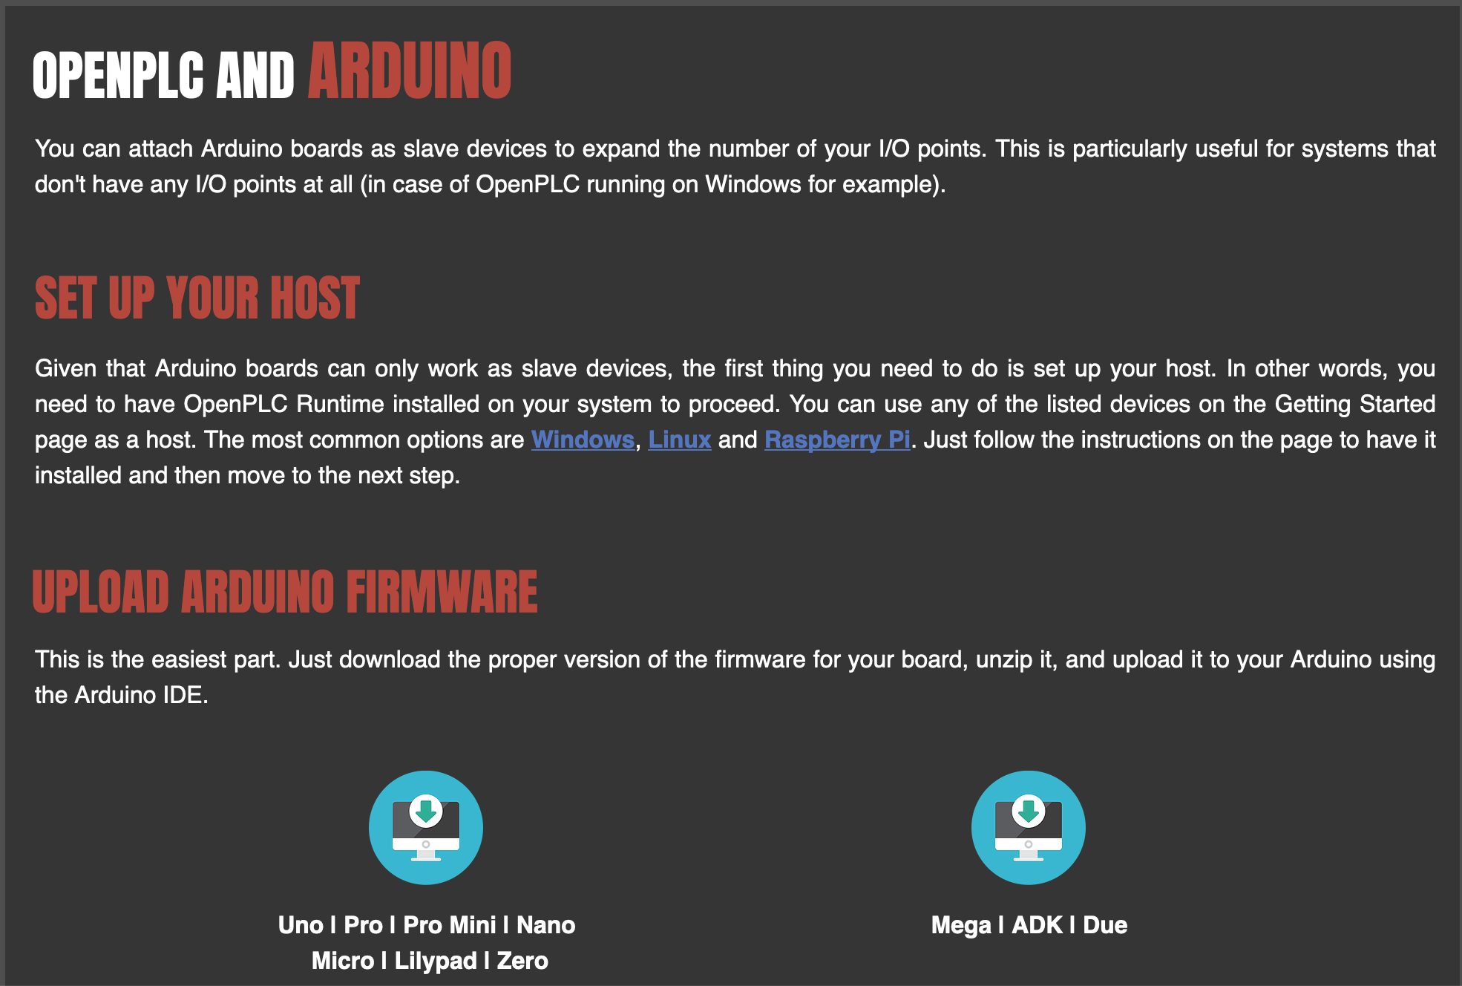
Download OpenPLC Firmware for Arduino Uno
Download firmware from
https://www.openplcproject.com/getting-started-arduino

Slide 9
Breadboarding of Circuits

Slide 10
Circuit Schematic
+V
PB1
%IX100.0
%QX100.0
OpenPLC Slave
Arduino Uno R3
R1
R3
%IX100.1
LED1
PB2
R2
Ground
+V is 5Volts for the Arduino
PB1 and PB2 are momentary pushbuttons
R1 = R2 = R3 = 1 k Ohm resistor
LED1 is a light emitting diode (LED)

Slide 11
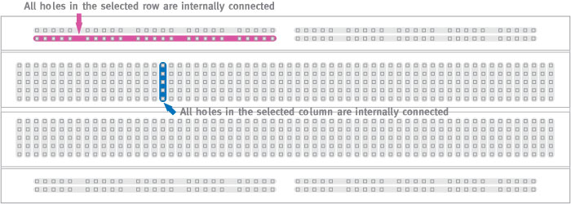
Circuit Components – Prototyping Breadboards
http://wiring.org.co/learning/tutorials/breadboard/

Slide 12
Cyber-Physical Systems: Circuit Hints
Breadboard your circuit before powering up the Arduino or Raspberry Pi
Check it carefully before applying power
Double check against the pinout diagrams
Be mindful of component voltage levels
Some may be 5V, others 3.3V
Routing 5V into a 3.3V device is usually bad
Level translation may be required
Learn to interpret the component datasheets
Look at min/max voltages and currents
May provide sample circuits that illustrate use of a particular component
Invest in a multimeter for measuring voltages, currents, resistance, and continuity

Slide 13
Cyber-Physical Systems: Circuit Hints
Most processor General Purpose Input/Output (GPIO) pins are not designed to drive low impedance/low resistance loads
Relay, solenoid, and motor coils require a driver circuit that can supply more current than the GPIO pins
LEDs typically require a series resistor to limit current draw
Resistor too large allows too little current flow (dim LED)
Resistor too small or non-existent allows too much current flow (bad)
Failure to limit current sourcing/sinking through GPIO pins may result in permanent damage to the Raspberry Pi (or Arduino)
Relay/solenoid coils may require a parallel diode to dissipate back EMF (current flowing from collapsing magnetic field)

Slide 14
Circuit Components – Resistors - 1
I
I
+ V -
+ V -
Ohm’s Law
Voltage = Current x Resistance
V = I x R
Current calculations for 1k ohm resistor with 5 V and 3.3 V circuits
I = V / R = 3.3 volts/1000 ohm = 3.3 milliamps (mA)
I = V / R = 5.0 volts/1000 ohm = 5.0 milliamps (mA)

Slide 15
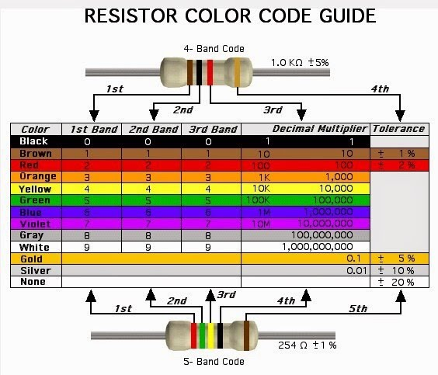
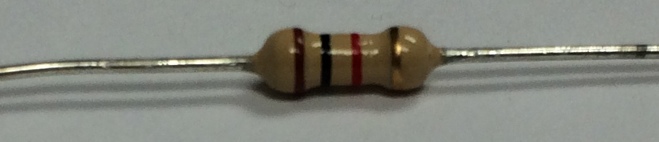
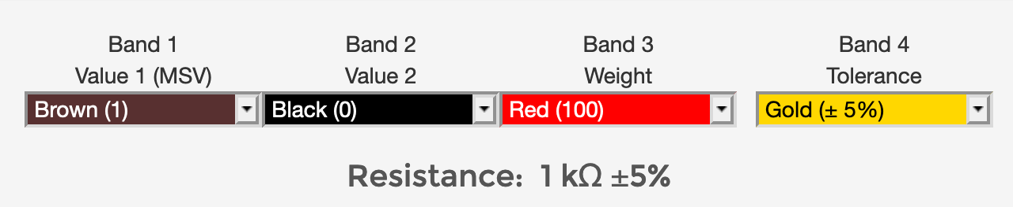
Circuit Components – Resistors - 2
https://sites.google.com/site/kmitl58010166/home/lab-i-basic-resistive-circuit-calculations-and-measurements
Photograph of 1 kOhm resistor
Sample output from online resistance calculator at URL below
https://learn.sparkfun.com/tutorials/resistors

Slide 16
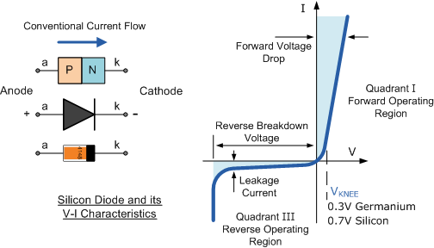
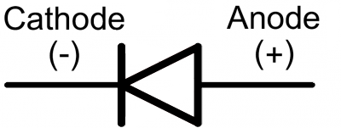
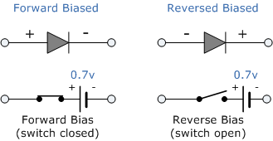
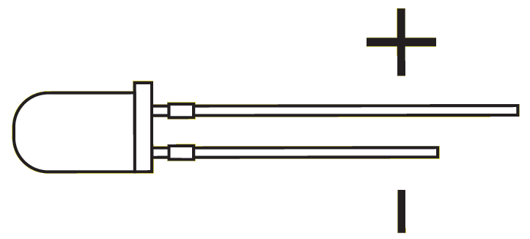
Circuit Components - Diodes
Signal Diode
“one-way current check valve”
Light Emitting Diode (LED)
https://cdn.sparkfun.com/assets/learn_tutorials/7/5/backwardsDiode.png
https://www.electronics-tutorials.ws/diode/diode_4.html

Slide 17
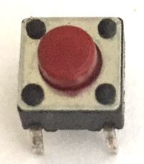
Circuit Components - Pushbuttons
A
A
B
B
A
B
A
B
Switch Open
(Normally Open)
Switch Closed
(Switch Pressed)
https://components101.com/switches/push-button

Slide 18
References
The OpenPLC Project
https://www.openplcproject.com/
Horowitz and Hill, The Art of Electronics 2nd ed.
Good overview of digital and analog circuits with many examples including interfacing to sensors and actuators such as those in a cyber-physical system

